Slide 1

Three Questions
John 21:15-23

Slide 2
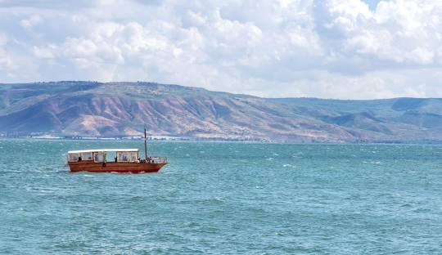
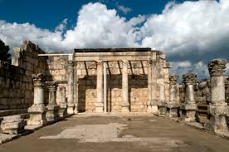
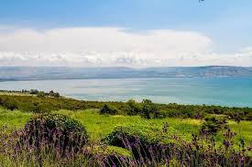
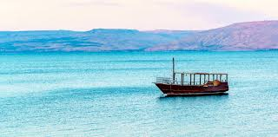
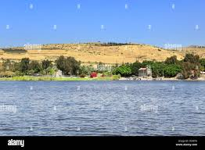
Sea of Galilee

Slide 3
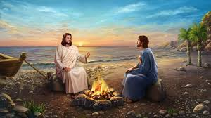
John 21:15-17, ‘When they had finished eating, Jesus said to Simon Peter, “Simon son of John, do you love me more than these?” “Yes, Lord,” he said, “you know that I love you.” Jesus said, “Feed my lambs.” Again Jesus said, “Simon son of John, do you love me?” He answered, “Yes, Lord, you know that I love you. Jesus said, “Take care of my sheep.” The third time he said to him, “Simon son of John, do you love me?’. Peter was hurt because Jesus asked him the third time, “Do you love me?” He said, “Lord, you know all things; you know that I love you.” Jesus said, “Feed my sheep.

Slide 4

1) Do you love me?
Grammatical Forms
Questions
In the Present
Love more than others
Agape love? Philia Love?
John 21:15 Jesus: ‘Do you love (Agape) me more than these?’ Peter: ‘Yes, you know that’
John 21:16 Jesus: ‘Do you love (Agape) me? Peter: ‘Yes, Iove (Philia) you
John 21:17 Jesus: ‘Do you love (Philia) me? Peter: ‘Yes, you know that I love (Philia) you
C.S. Lewis, 'The Four Loves’.
. Storge (Parental affection)
. Philia (Friendship)
. Eros (Romans)
. Agape (God’s Love)

Slide 5
Leonard Sweet,
‘What is Christianity? It is Christ nothing more and nothing else. The disease the modern church suffers is Jesus deficiency disorder. If the church loves Jesus as mush as the world loves Jesus, everyone in the world will respect the church’
More Love to thee, O Christ(Hymn)
More Love to thee, O Christ, More Love to thee
Here thou the Prayer I make on bended knee
This is my earnest plea More Love , O Christ to thee
More love to thee, More love to thee
In Moment like these (Song)
In moment like these I sing out a song I sing out a love song to Jesus. In moment like these I lift up my hands I lift up my hands to the Lord. Singing I love you Lord, I love you Lord, Singing Love you Lord, Love you Lord, singing love you Lord’.

Slide 6
2) Feed my lamb
Act 20:28, ‘Keep watch over yourselves and all the flock of which the Holy Spirit has made you overseers. Be shepherds of the church of God, which he bought with his own blood. I know that after I leave, savage wolves will come in among you and will not spare the flock. Even from your own number men will arise and distort the truth in order to draw away disciples after them. So be on your guard! Remember that for three years I never stopped warning each of you night and day with tears. Now I commit you to God and to the word of his grace, which can build you up and give you an inheritance among all those who are sanctified’.
The Church was founded by the blood of Jesus
Holy Spirit has appointed you as a shepherd
(3) Keep watch over mt flock
4 types of sheep
. unbelievers outside the church
. believers outside the church
. believers who are wandering in the church
. unbelievers in the church

Slide 7
Shepherding in the wilderness
3 ministries of the Shepherd (Ezekiel 34)
. Seeking (11-12)
. Feeding (13-14)
. Caring (15-16)
4 ways of getting water in the wilderness
4 processes to restore the fallen sheep
Remove | Shade (for protection from the heat)
Drink | Water (for being thirsty)
Massage | Body (for touching)
Provide | Food (for being hungry)
Dew | Hos 14:5, ‘I will be like dew to Israel...’ | Dew at dawn everyday
Spring | John 7:3, ‘...river of living water will flow from within them’ | Natural spring welling up all the time
Cistern | Jer 2:13, My people have committed two sins: They have forsaken me, the spring of living water, and have dug their own cisterns broken cisterns that cannot hold water’ | Well dug from the earth
Rain | Zech 10:1, ‘Ask the Lord for rain in the springtime. it is the Lord who sends the thunder storms. He gives a showers of rain to all people and plants of the field to everyone’. | Rain from the heaven in rainy season

Slide 8
Pastoral ways to take care of the sheep
6p and 4F
3S
Spend time with them | Shopping, Fishing, Watching Movies, Birthday Party, Sports
Serve them | ‘When we meet the unbelievers, we want to speak the gospel, but they want to be loved’. That is the Needs-centered Evangelism. Before telling the good news, show the good love to them. Take care of her babies, transport his children to school, celebrate her birthday, visit his mother’s hospital, congratulate his daughter’s graduation, help his house moving, ‘Meet the needs, then he will follow your path’.
Supply for them | Food, Rest, Enjoyment, Spiritual Needs, learning, Whatever he needs
Phone (call)
Pen (letter)
Pastor (food)
Presents (gift)
Picnic (Travel)
Play (sports)
Fun
Food
Film
Favorite things

Slide 9
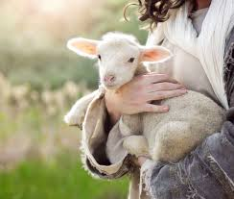
Responsibility of the cell leader for caring the cell group
1. Attending at the Cell Leader Meeting after Sunday Service and attending at the annual Cell Leader Conference
2. Attending at all official worships in the church
3. Praying for 20 minutes every day over 5 days a week
4. Reading the Bible 3 chapters every day over 5 days a week
5. Praying for the cell group members over 2 times a week
6. Offering tithes to the church as a good steward
7. Evangelizing over 1 person a year and pray for him
8. Visiting New Members every week and report to the Church
John 10:1-4, “Very truly I tell you anyone who does not enter the sheep pen by the gate, but climbs in by some other way, is a thief and a robber. The one who enters by the gate is the shepherd of the sheep. The gatekeeper opens the gate for him, and the sheep listen to his voice. He calls his own sheep by name and leads them out. When he has brought out all his own, he goes on ahead of them, and his sheep follow him because they know his voice.

Slide 10
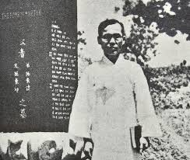
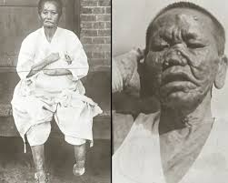
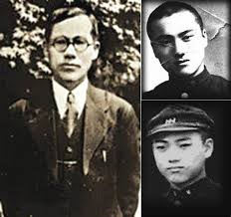
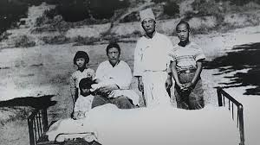
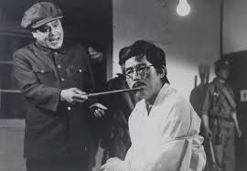
Pastor Son’s Love for the sheep

Slide 11
10 Gratitude to God
First, thank you for bringing these martyred children out of the bloodline of sinners like me.
Second, Thank you for giving such precious children among the people.
Third, thank you for dedicating to God the two most beautiful sons of three sons and three daughters: the firstborn and the second son.
Fourth, martyrdom of one son is also precious, and thank you for making these two sons martyred.
Fifth, it is a great blessing to die while believing in Jesus, but I am thankful for being martyred while evangelizing.
.
Sixth, my son who was preparing to go to study in the US, thank you for letting him go to a better heaven than in the US.
Seventh, the enemy who killed my two beloved sons Thank you for giving me a heart to love me.
Eighth, I am thankful that there will be countless children in heaven through the martyrdom of my two sons.
Ninth, thank you for giving me the words of truth and faith to rely on God’s love even in adversity. Thank you for blessing me, a sinner, so that I can glorify God.
Tenth, thank you for blessing me, a sinner, so that I can glorify God. Thank you for answering the prayer I prayed with tears and for the fruit that my beloved leper brothers and sisters have prayed for me and my family for 23 years.

Slide 12
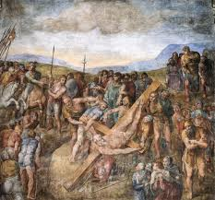
3) Follow Me
John 21:18-19, “Truly, truly, I say to you, when you were young, you girded yourself and walked where you wished; but when you are old, you will stretch out your arms, and another will gird you and take you where you do not want to go... ‘Follow me.”
Three Follow Me in N.T
Matthew 4:19 | Matthew 19:21 | John 21:19
Come to be disciple | Learn for being disciple | Send to make disciples
Jean Vanier, ‘The Church exists for the people inside, and exists with the people outside’.
Grace Aylward, ‘A flying eagle in the heaven does not worry about crossing a river in the earth’.
John Wesley, “The best thing is that God is with us”.

Slide 13
After finishing the first semester
Do You Love Me?
Do you feed my Lamb?
Do you follow me?

